Slide 1
Time Frequency representation deformation
Philippe Chuzel
Under the supervision of:
Jean-Christophe Cexus / Arnaud Coatanhay

Slide 2
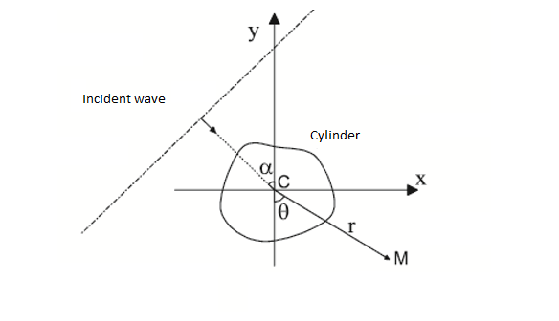
Introduction
Study of the wave scattered by an object which form change through time.
Create a processing chain in order to analyse the different frequency law which compose a signal.
Apply this chain on the signal we want to study.
Object

Slide 3
Content
I/ Generation of the signal
Physical model
II/ Time-Frequency representation
Spectrogram
Equations resulting
Wigner-Ville distribution
III/ Presentation of the processing chain
Seam Carving algorithm
Fit Spline interpolation
IV/ Application on the subject

Slide 4
Generation of the signal
1) Physical model
M : Observer
θ : Angle with the observer
 : Angle of the incident wave
Object

Slide 5
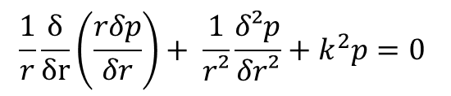
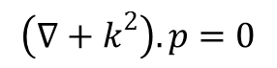
2) Equations resulting
Generation of the signal
The equation of the wave is :
$$\left(∇+k^{2}\right).p=0$$
In cylinder landmark, this equation becomes:
$$\frac{1}{r}\frac{δ}{δr}\left(\frac{rδp}{δr}\right)+ \frac{1}{r²}\frac{δ²p}{δr²}+k^{2}p=0$$
Thanks to some proprieties of the partial differential equation, we can express the solution as a set of the functions:
$J_{n}\left(k.r\right)e^{i.n.θ} Y_{n}\left(k.r\right)e^{−i.n.θ} n∈Z$
or
$$H_{n}^{\left(1\right)}\left(k.r\right)e^{i.n.θ} H_{n}^{\left(1\right)}\left(k.r\right)e^{−i.n.θ} n∈Z$$

Slide 6
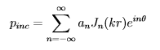
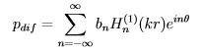
2) Equations resulting
Generation of the signal
That’s why we can express the incient wave and the wave scattered as:
Finally, we can find the value of an and bn with the condition of DIRICHLET and SOMMERFELD and thanks to Fourier series decomposition.

Slide 7
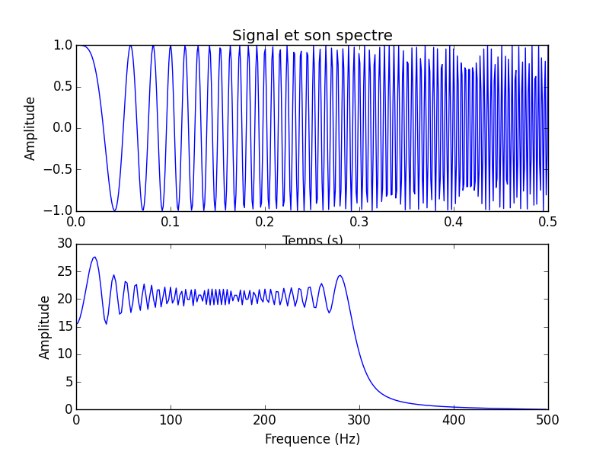
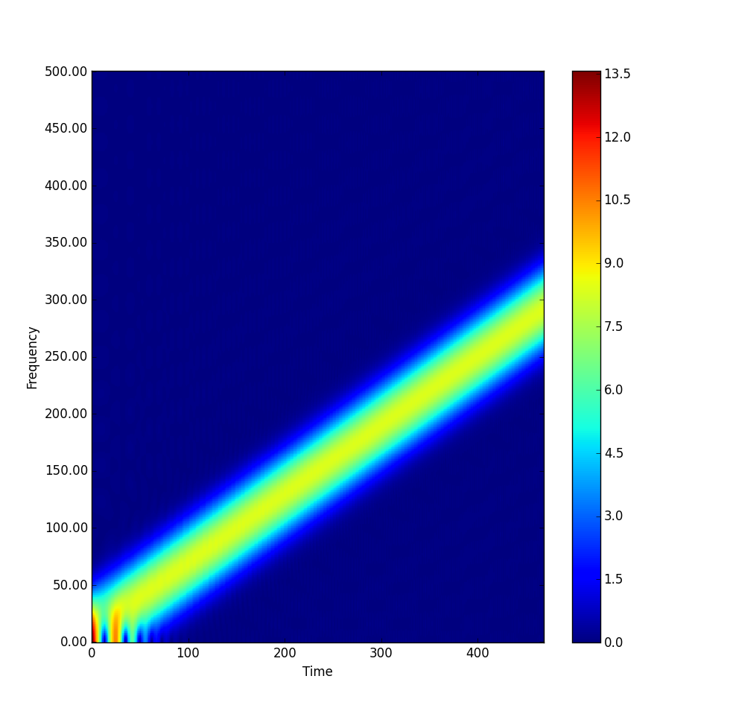
II/ Time-Frequency representation
1) Spectrogram

Slide 8
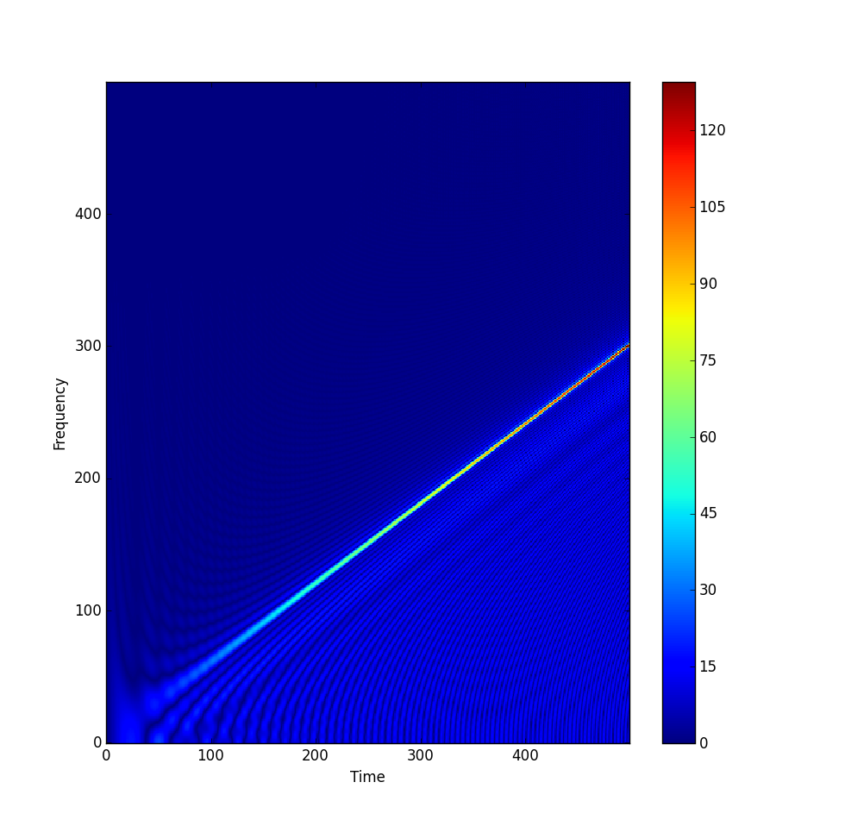
II/ Time-Frequency representation
2) Wigner-Ville distribution

Slide 9
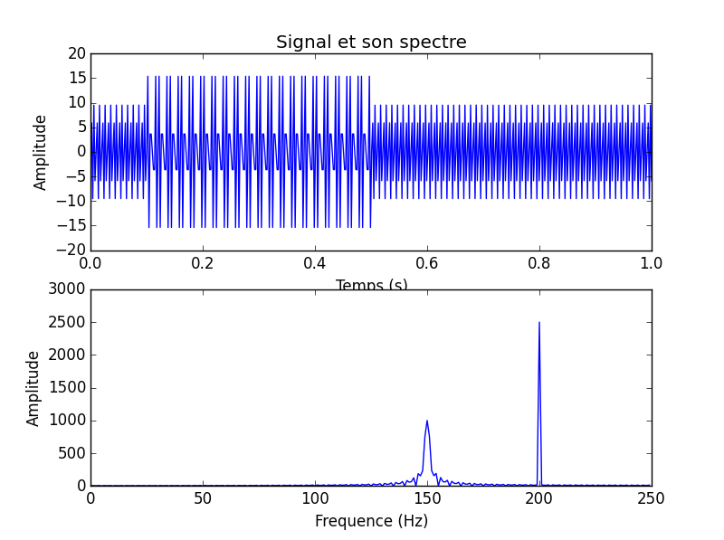
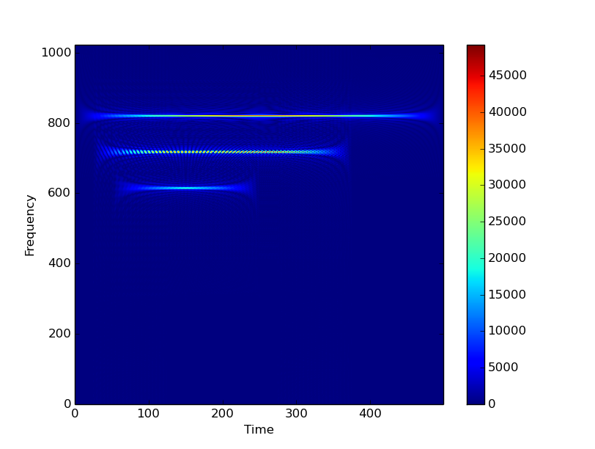
II/ Time-Frequency representation
2) Wigner-Ville distribution

Slide 10
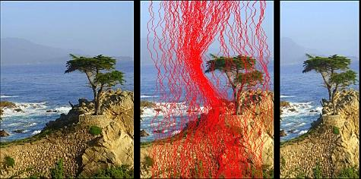
III/ Presentation of the processing chain
1) Seam Carving algorithm
This algorithm is used for image resizing but it can be used for this project.
Idea: find a path in the TFR which represent one frequency law of the signal.

Slide 11
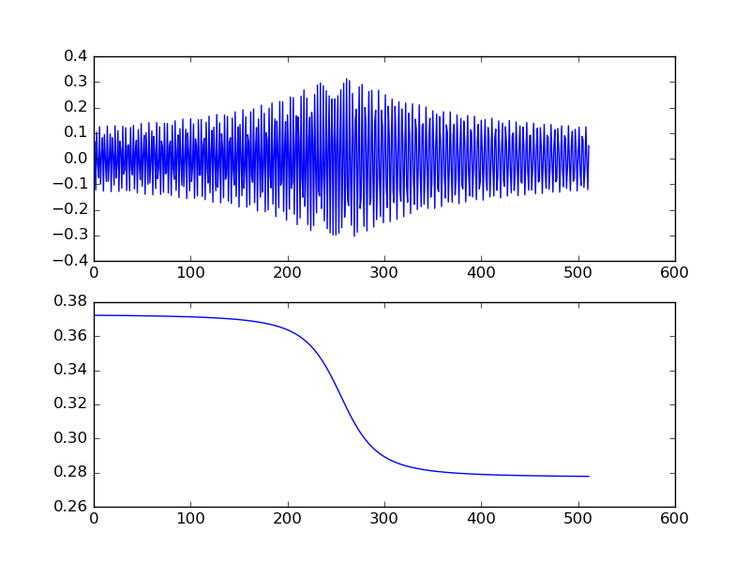
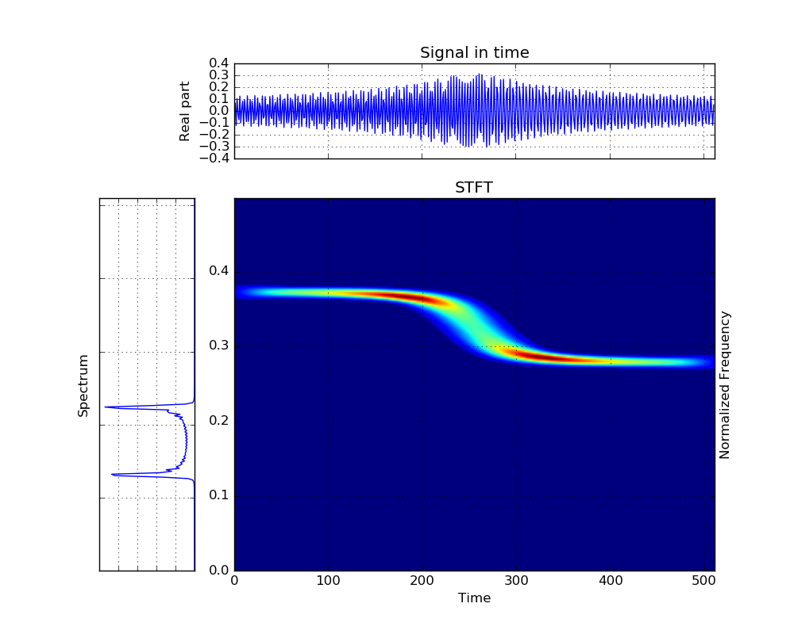
III/ Presentation of the processing chain
1) Seam Carving algorithm

Slide 12
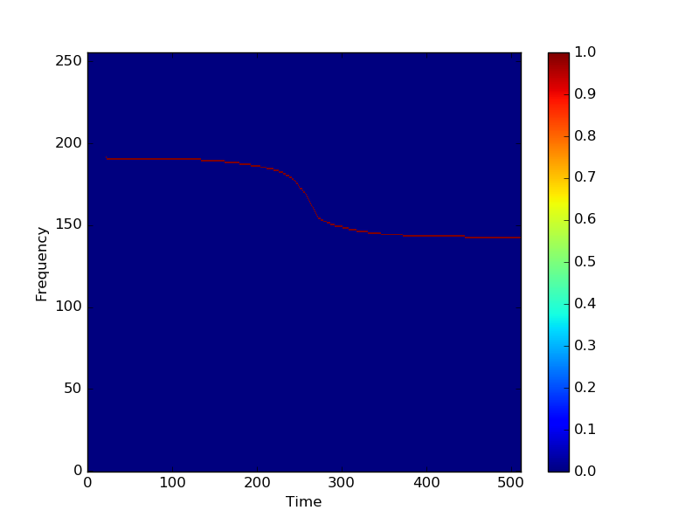
III/ Presentation of the processing chain
1) Seam Carving algorithm
Result of the seam carving algorithm:

Slide 13
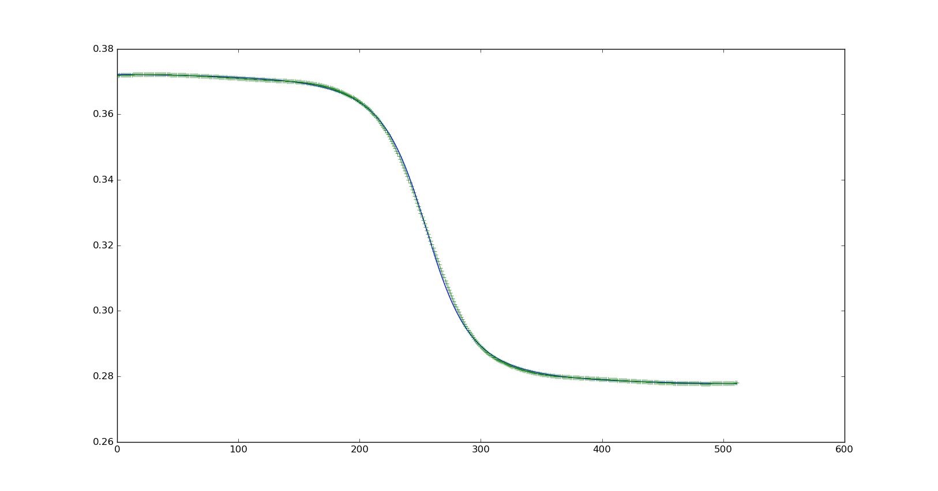
III/ Presentation of the processing chain
2) Fit Spline interpolation
Spline: Algorithm which interpolate a function with polynomial.

Slide 14
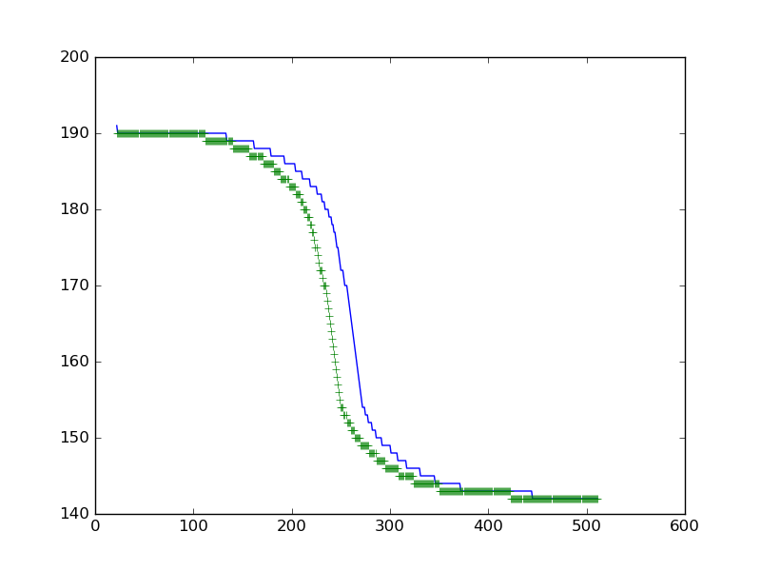
III/ Presentation of the processing chain
2) Fit Spline interpolation
Impact of the parameters and the type of function studied

Slide 15
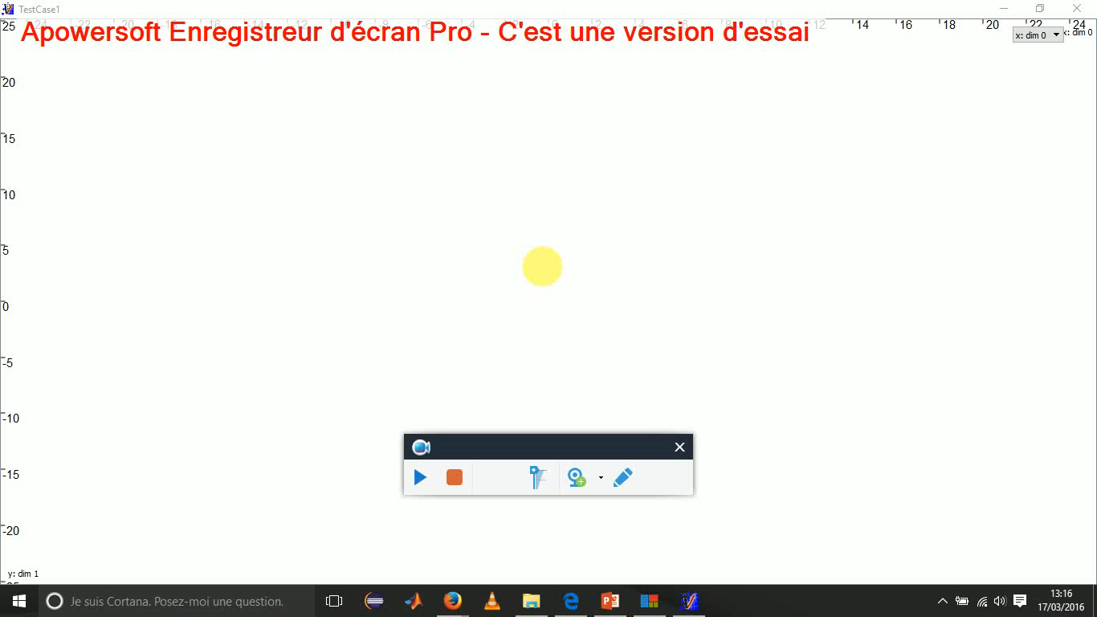
IV/ Application on the subject

Slide 16
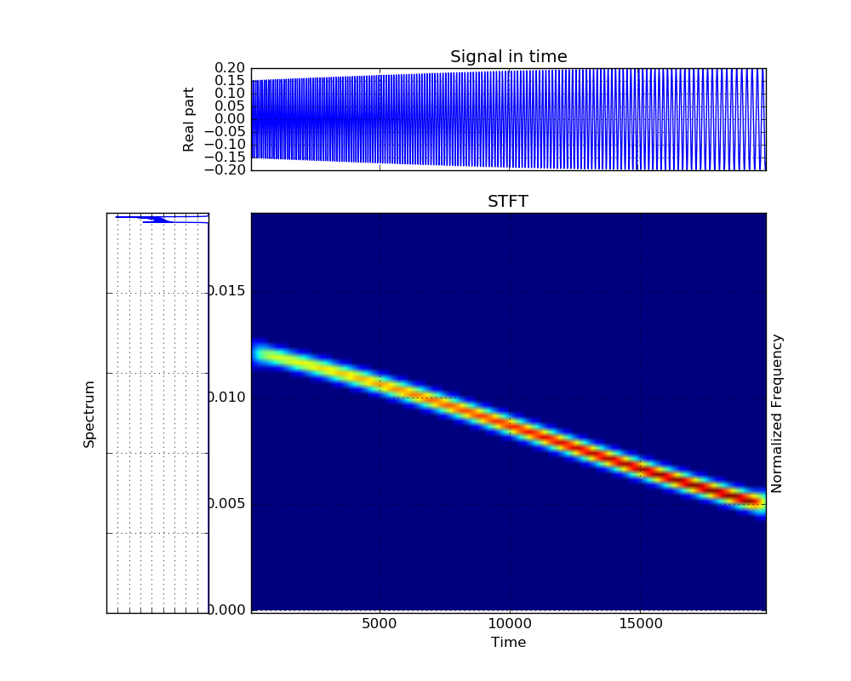
IV/ Application on the subject

Slide 17
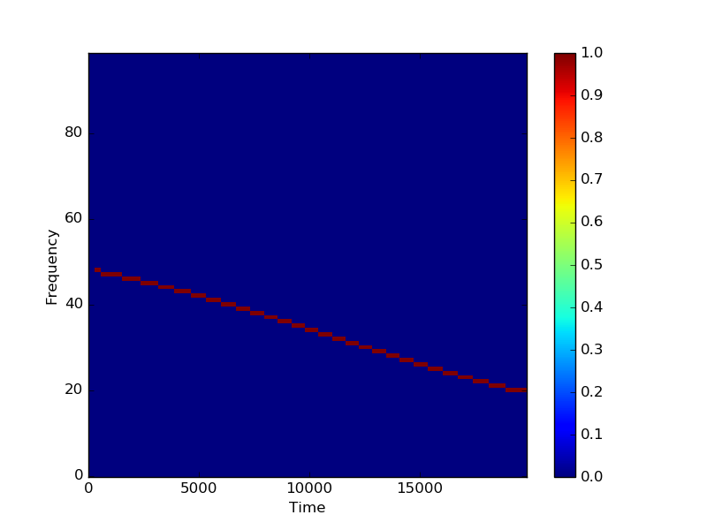
IV/ Application on the subject

Slide 18
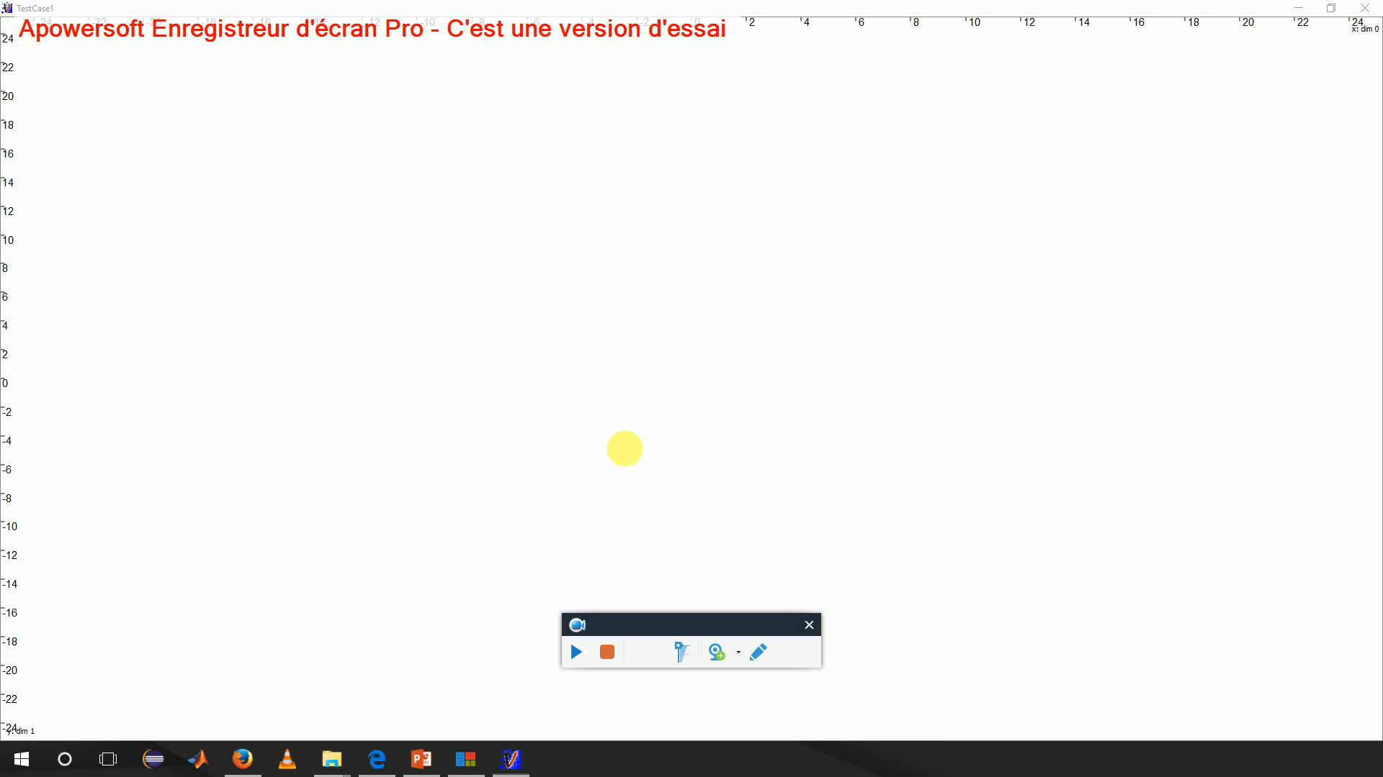
IV/ Application on the subject

Slide 19
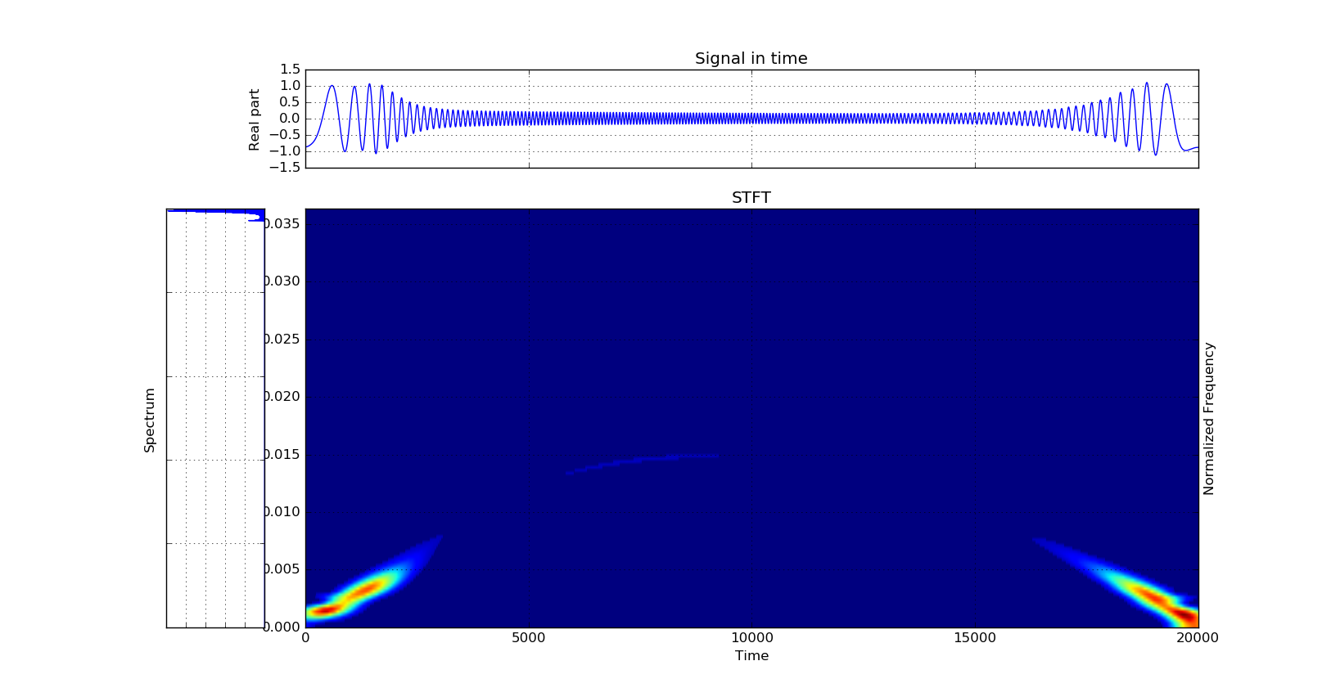
IV/ Application on the subject

Slide 20
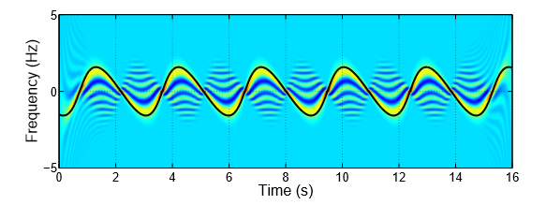
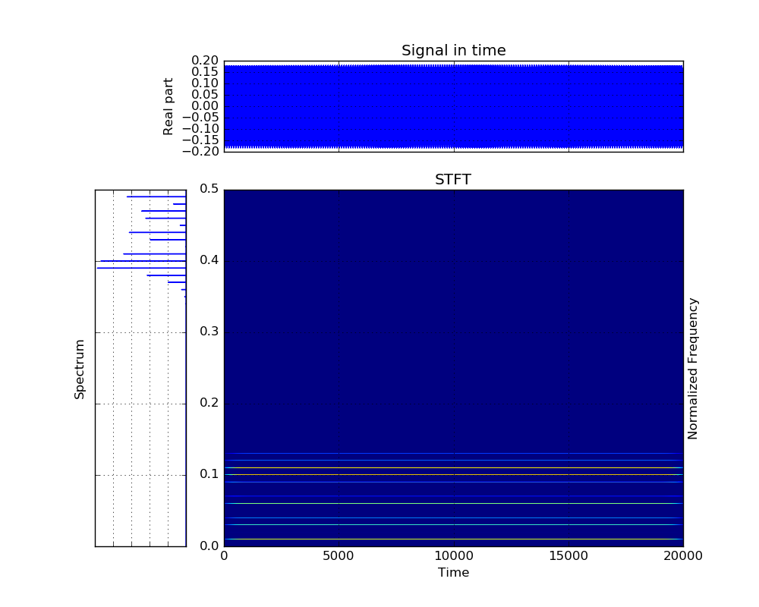
IV/ Application on the subject Problem : Visualization of the effect of the radius variation

Slide 21
Conclusion
About what was expected :
One program can generate any signal and can also simulate the movement of the object. In the end, we can get the position of the object and of the observer, the ﬁeld scattered and the ﬁled incident during the simulation.
One program shows how we can use all the different time-frequency representation.
One last program explain how we can use all the tools developed for any kind of signal.
Nevertheless :
We still can’t see the effect of the radius variation on the frequency laws.

Slide 22
QUESTIONS?

Slide 23
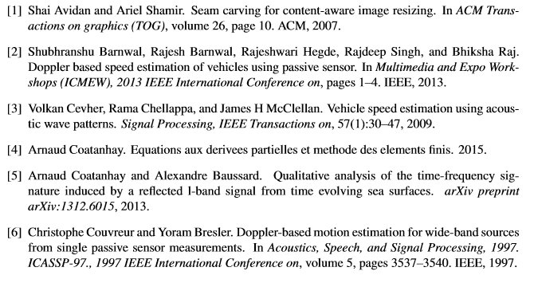
Bibliography

